Slide 1

UNIT 4
DISTRIBUTED AND MULTIMEDIA IR

Slide 2
Distributed IR
Distributed information retrieval system is an IR system design to investigate data that distribute across various sources.
Using the distributed information retrieval (DIR) model a user can access multiple databases that are distributed across multiple places
DIR also known as federated information retrieval and federated search
Examples are:- Google search engine, pubmed, westlaw, Medline
1

Slide 3
Why is DIR necessary?
There are restrictions on what search engine can find on Internet. For example, not everything on the Internet is extractable and a web search engine's "single partition contains all" strategy has many drawbacks
Frequently, there are various types of responses to the same query. Thus, the need for deep web Federated search, metasearch and aggregated search required
2

Slide 4
Distributed systems typically consist of :
A set of server processes - each running on a separate node, and a designated broker process.
The broker :
accepts clients requests and distributes the requests to the servers,
collects intermediate results from the servers, and combines the intermediate results into a final result for the client
The communication between the subtasks is performed using a network protocol such as TCP/IP

Slide 5
Federated Search
It is also called as Federated information retrieval.
It sends a user query to the resource's search tool. User can search multiple data sources simultaneously using federated search by sending a single query.
The federator gathers result from one or more search engines and then present all of the results in a single user terminal.
It is preferable because it reduces the time and efforts required, increases searchability and productivity
Query
Federated search engine
Results
Search
Engine
Search
Engine
Search
Engine
Index
Index
Index
4
3

Slide 6
Federated search - technique used to search multiple data sources at once.
Federated search - retrieve information from many different content locations with just one query and one search interface.
You may have encountered federated search without realizing

Slide 7
Metasearch
Produces own results by using an online information retrieval tool that uses the data of a web search engine
Metasearch engines take input from a user and immediately query search engines for results.
Sufficient data is gathered, ranked, and presented
Eg - Dogpile, MetaCrawler, SUSI, Ixquick

Slide 8
Aggregated Search
Technique involves querying multiple search engines or databases simultaneously to retrieve and present combined search results to the user
Gathers the information in mass quantity (huge)

Slide 9
Architecture of Distributed IR
Client 1
N
E
T
W
O
R
K
N
E
T
W
O
R
K
Server 1
Client 2
Select collection
Server 2
Client 3
Server 3
Combined results
Client n
Server n
4

Slide 10
Distributed IR architecture enables user to simultaneously search various document collections.
Connection server connects a group of clients to group of IR systems, so that communication between clients and IR system is handled by connection server.
Distributed systems typically consist of a set of server processes, each running on a separate processing node, and a designated broker process for accepting client requests, distributing the requests to the servers, collecting intermediate results from the servers, and combining the intermediate into a final result for the client.
This setup allows for improved scalability, fault tolerance, and performance
5

Slide 11
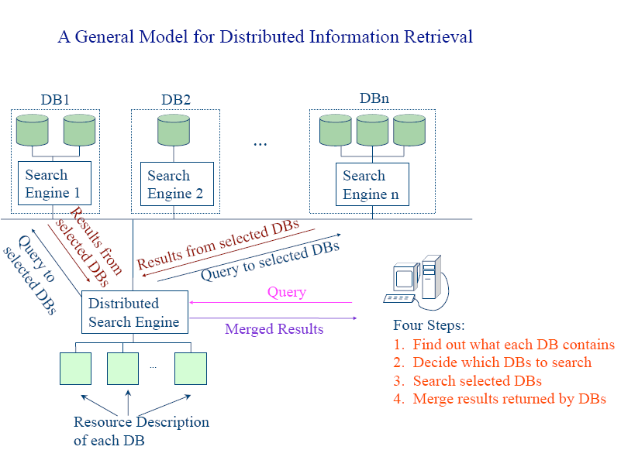

Slide 12
Collection Partitioning
Collection partitioning refers to the practice of dividing a large dataset or collection into smaller, more manageable segments or partitions.
Each partition can be processed independently, which can lead to better resource utilization and faster data access.
This is often done to improve performance, scalability, and ease of maintenance.
It's commonly used in databases, distributed systems, and parallel processing environments
6

Slide 13
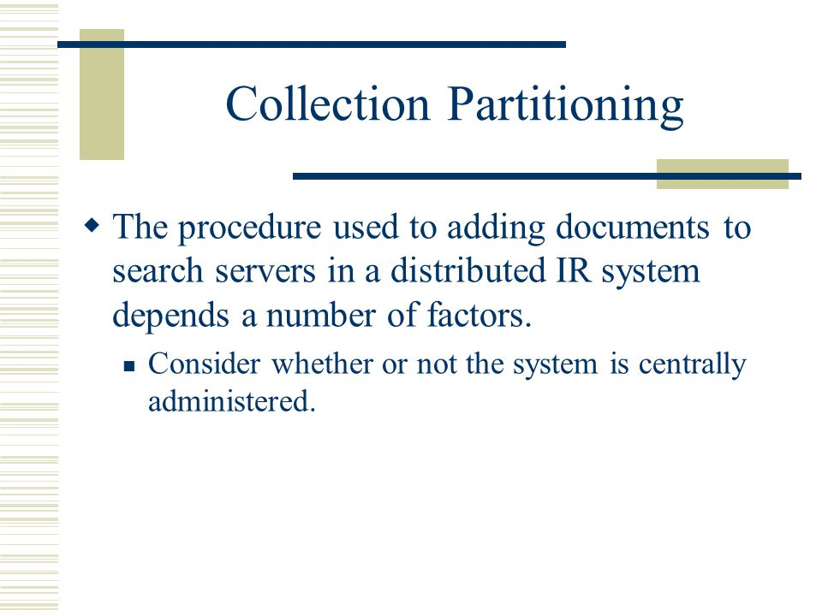

Slide 14
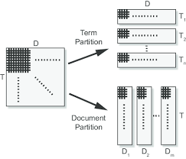

Slide 15
ADVANTAGES
appropriate when collection is small.
-parallelism is achieved by multitasking.
-Broker has to route the queries to the servers and balance the load on the servers.
-Indexing can be done by two ways
-each server separately indexes its replica of the documents.
-Each server is assigned mutually exclusive subset of docs
to index and the index subsets are replicated across the search servers.
-A merge of subsets is required at each server to create a final index.
-In both cases document additions and deletions must be broadcasted

Slide 16
Partitioning of Collections in a Decentralized System
Partitioning of Collections in a Centralized System
it involves distributing data across multiple nodes or devices without relying on a central server
It's done for scalability, fault tolerance, and load balancing.
Challenges include synchronization and handling node failure.
it involves dividing a dataset or collection into smaller subsets within a single, central server or database.
it's done to improve query performance, manageability, and data organization.
Challenges include data consistency and potential load imbalances.
7

Slide 17
Source Selection
It is the process of choosing appropriate information sources, such as databases, websites, or repositories, to retrieve relevant and accurate information.
The basic strategy is to generate a collection vector and compare it to the query vector, treating each collection as if it were a single enormous document.
It involves evaluating the reliability, credibility, and relevance of sources based on research needs.
Factors like authority, currency, objectivity, and the reputation of the source should be considered when selecting sources for your research.
8

Slide 18
How to select which server should get a particular request
Source selection-
It is the process of determining which of the distributed document collections are most likely to contain relevant documents for the query.
Two approaches
Assume that each collection is equally relevant.
By Ranking the collections

Slide 19
Assume that each collection is equally relevant.
-In this case the query is broadcasted to all collections.
-This approach is feasible if collections are randomly partitioned or there is significant semantic overlap between the collections

Slide 20
RANKING THE COLLECTION
Useful when semantic partitioning of collection is done.
Or if it is costly to search every collection every time .
Idea-
Every collection is treated as a single large document.
Index this collection
By using “cosine measure” find similarity between this large document and query.
Rank the result.
Search only highly ranked large document

Slide 21
Query Processing
Query processing refers to the steps involved in executing a user's query or request on a database.
It involves following steps:
Choose the collection to search
Send the query to the chosen collection
Parallel evaluation of queries at dispersed collections
Combine results from distributed collections into final product.
It involves parsing, optimizing, and executing the query to retrieve the desired information from the database.
9

Slide 22
Issues with distributed IR
Resource description: Each text database's contents must be explained.
Resource selection: Choosing which database(s) to search requires consideration of an information demand and a list of resource descriptions.
Merging Results: Combining the ranked lists that each database returned to create a single, cohesive ranked list.
it is also more complicated than the information retrieval model using a single database,
10

Slide 23
Intro to Multimedia IR
Multimedia Information Retrieval (IR) is a field that focuses on retrieving and organizing different types of multimedia data, such as images, videos, audio, and text, to facilitate efficient and effective information retrieval.
MIR tries to extract semantic data from multimedia data sources.
The goal is to develop techniques and systems that allow users to search, browse, and retrieve multimedia content based on their information needs.
Applications of multimedia IR include image and video search engines, music recommendation systems, video summarization, and medical image retrieval.
11

Slide 24
NEED of MULTIMEDIA IR
Multimedia data is rapidly growing
Many applications work on multimedia data e.g
CAD/CAM
Medical app.'s
Bioinformatics
Most important characteristic of a multimedia information system is the variety of data it must be able to support.
Multimedia system must have the capability to store, retrieve, transport and present data with very heterogeneous characteristics such as text, images, graphs, sound.
Conventional system deals with simple data types like text, integer and are unable to support the mix of structured and unstructured data and multimedia data.
Characteristic of multimedia information system is the variety of data it can support.
The architecture of a Multimedia IR system depends on two main factors
The peculiar characteristics of multimedia data
The kind of operations to be performed on such data

Slide 25
Sr.No | Multimedia IR System | Traditional IR System
1 | Structure of multimedia objects is more complex | Textual data is simple
2 | Uses Information retrieval, Multimedia DB mgmt system, DB mgmt system | Uses Information retrieval, DB mgmt system
3 | Support large variety of data Text, Image, audio, video | Support only textual data.
4 | Heterogeneous characteristics of data | Homogeneous characteristics of data
5 | Supports Structured +unstructured + semi structured data | Supports unstructured
6 | Can handle metadata | Can’t handle metadata
7 | Multimedia objects require large amount of space | Less space
8 | Content of multimedia object is difficult to analyze and compare | Easy to analyze and compare
9 | Handles attribute based and content based queries.eg retrieve all docs having image of car. | Handles attribute based queries .

Slide 26
Data modeling
A Model of Multimedia information Retrieval
Computing methodologies
Information System
Artificial intelligence
Artificial intelligence
Computer vision
representation
Evaluation of retrieval result
Relevance
assessment
Computer vision
Image representation
Information retrieval query processing
knowledge representation
and reasoning
Retrieval models for ranking
12

Slide 27
The model provides retrieval functionality across two media, text and image, as well as multiple dimensions , including form, content and organization.
web search engine : pictures, audio files and movies (non-text format)
difficulty : to provide “retrieval by content ” ( we require CONTENT OF OBJECT instead of metadata or textual descriptions)
13

Slide 29
Query language
Query language is a structured method for users to express their information needs and retrieve relevant multimedia content from a database or collection
A query language defines a set of syntax and semantics that users can use to formulate queries and interact with the MIR system.
The syntax of a query language defines the rules for constructing valid queries.
The semantics of a query language determine the meaning of the queries and how they are interpreted by the system.
Examples: SQL-like languages for querying multimedia databases, content-based image retrieval (CBIR) languages for querying image databases using visual features, and audio query languages for retrieving audio content based on sound characteristics.
14

Slide 30
Background special access method
A Background Spatial Access Method (BSAM) is a data structure and indexing technique used in spatial databases and geographic information systems (GIS) to efficiently manage and retrieve spatial data.
BSAMs are particularly useful in scenarios where spatial databases need to handle large volumes of data and provide near-real-time responsiveness to queries.
BSAM offloads indexing process to the background, allowing the main database operations to continue without being heavily affected.
15

Slide 31
Generic multimedia indexing approach
It is a general strategy or framework used to index and organize multimedia data in a way that enables efficient retrieval and analysis.
This approach aims to address the challenges posed by different types of multimedia data, including images, audio, video, and other non-textual content.
The main objective of multimedia indexing is to efficiently support multimedia similarity search, which is the basis of the majority of multimedia applications.
16

Slide 32
Generic multimedia indexing (GEMINI) algorithm
Determine the distance between two items using the d) function. eg. d() (01, 02)
To perform a "quick-and-dirty" test, locate one or more numeric feature extractions.
Establish the bottom boundaries of the distance in feature space to the actual order to distance D0 in confirm accuracy
Use a suitable data structure to save and retrieve each collection object's 1-dimensional features.
17

Slide 33
One dimentional time series
It is an open-source platform for machine learning optimization of search result relevance in genomic data repositories is built on the foundation of GEMINI
Achieving faster-than-sequential searching through the use of spatial access techniques.
Multimedia objects can have a very big dimensionality, which is why the distance computation is expensive
The one-dimensional or two-dimensional quick-and-dirty test is intended to scale down this complexity to more manageable dimensions.
Two dimensional color image: uses for 2D color image search, color image based search
18

Slide 34
Feature extraction methods
It is the process of transforming raw textual data into a structured and compact representation that captures the key characteristics of the text
Automatic Feature Extraction :
It is the process of automatically generating relevant features from textual data to enhance the efficiency and accuracy of information retrieval systems.
This approach aims to create meaningful and representative features from the text without requiring manual feature engineering
These features are then used for indexing, searching, and ranking documents in response to user queries.
GEMINI is helpful for feature extraction
Algorithm AFT are Multidimensional Scaling, Fast Map
19

Slide 35
Trends
One of the most difficult and rapidly expanding study fields is content extraction, indexing, and retrieval of multimedia data.
The requirement for advanced technology to encode, model, index, and retrieve multimedia data is a result of the rising consumer demand for multimedia information
Trends in information storage and retrieval (ISR) are driven by technological advancements, changing user behaviors, and evolving data types.
These trends shape how information is managed, stored, accessed, and retrieved
20

Slide 36
Research issues
Analysis of multimedia input: complexity of multimedia inputs, huge volume, huge semantic gap
Output generation for multimedia: Multimedia content comes in various formats (images, videos, audio, text). Generating cohesive outputs that suit different formats can be complex, also summarization, interpretability of output
Multimedia Collaboration: to better understand how people cooperate, carefu and intelligent instrumentation and evaluation of collaboration spaces will be essential
Interfaces for agents : need for proper monitoring of agents, their behavior, how they conduct conversation is needs to be monitored well
21

Slide 37
Multimedia data support in commercial DBMS
Multimedia database is collection of related multimedia data that may include text, graphics, photos, animations, video, audio and other elements.
Database content are :
Media data - real time data used to portray object
Media format data - details of format of media data after it has been acquired
Media keyword data - keyword that describe how data is generated
Media feature data - information that depends on content like color, texture, shapes
22
applications are repository applications, presentation applications

Slide 38
Challenges of multimedia databases
Modeling: enhancement of database retrieval methods
Design: multimedia database uses range of formats these formats are difficult to convert into one another, design for such database is not thoroughly addressed.
Storage: representation, compression, mapping to device hierarchies, archiving and buffering during input-output operations becomes challenging while storing multimedia DB on disc.
Performance: video playback or audio- video synchronization may happen, also these DBs use lot of computing power, and bandwidth
Queries and retrieval: data can be retrieve through queries but it raises challenges such as query formation, execution, optimization.
23

Slide 39
MULTOS - multimedia filing system
MULTOS (Multimedia Filing System) is a database system for storing, retrieving, and managing multimedia content like images, videos, audio, and text.
It supports content-based retrieval, multimodal indexing, and offers user-friendly interfaces.
It's designed for scalability, customization, security, and integration with other software systems.
MULTOS is used to efficiently handle and retrieve multimedia data for various applications.
24

Slide 40
THANK YOU

